Slide 1
Alternative & Complementary Medicine : The Maghreb Experience
Mostefa Khiati
Abu Dhabi
2016-11-8/9

Slide 2
The Maghreb till 19th C.
Natural Medicine
Plants
Diet
thermal sources
Healed fractures and sprains
Performed trepanning

Slide 3
Naturalist Doctors
Abderazzek El-Djazairi 1107-1197 H
The book on drogues: 180 plants
He had malaria, he was treating himself with cinchona
Mohamed Benchaoua 19e c.
participited in the horticulture exhibition in Paris 1855
he presented a collection of 374 medicinal plants

Slide 4
The colonisation banned the practice of tradional medicine in the Maghreb
Trained few doctors
Algeria: 11 doctors in1909
Tunisia: first doctor in 1900
Morrocco: first doctor in 1940

Slide 5
After independance
Morrocco and et Tunisia in 1956
Algeria 1962
Enormous and complex health issues
Recourse to OMS to create heath systems

Slide 6
Role of the WHO founded April 7th 1948
1
Help to increase recognition of traditional medicine
Supporting its integration in national health-care systems according to it conditions of use in member countries
Provide guidance and technical information for a safe and effective use of traditional medicine
Preserve traditional medicine knowledge so that it is used in a sustainable manner
2
3
4

Slide 7
The four great objectives of the WHO:
Improve access to traditional medicine and make it more affordable;
Integrating pertinent aspects of traditional medicine in national health-care systems by formulating national policies in terms of traditional medicine and implementing programs;
Promote the rational use of traditional medicine;
Promote the efficiency and quality of traditional medicine practices by issuing guidance on regulation and quality insurance.

Slide 8
Integrating Traditional Medicine in Primary Health Care
Exemple: la Région du Pacifique occidental
in 1994, only four countries had a national policy in place, pertaining to traditional medicine
in 2001: their number went up to 14.

Slide 9
The Need for an Inclusive Policy
Role of authorities in the development of traditional medicine in the health-care system is
Formulating a mission,
Goals
And objectives.

Slide 10
The Integration of Traditional Medicine in the National Health-Care System
Will allow both systems to perform together effectively,
In the interests of authorities,
Of patients,
And consumers.

Slide 11
Traditional Medicine Strategy WHO 2002
Therapies and most widespread therapeutic techniques in the world
1
2
Patients :
If modern medicine fails, it does not involve treatment with medication or chemical products and involves less side-effects.
Non patients:
To improve their well-beings and avoid getting sick

Slide 12
State of Affairs: Today
Traditional medicine is practiced both by traditional healers and medical doctors
01
02
CANADA (GP)
57 % of therapies are plant-based, 31 % of treatments done with chiropractics et 24 % with acupuncture.
Pays-bas (50% GP)
Prescribe medicinal plants and practice manual therapies and acupuncture.
Between 1995-2000: x2 training with 10 800.

Slide 13
Age : especially those above 30.
Two out of three people have used a form of alternative medicine
Epidemiology in the Maghreb
Predominance of women (4 out of 5)
Procedures often performed by medical doctors (acupuncture, hijama…)
At all levels, especially for chronically illnesses, middle and rural level: early use.

Slide 14
Alternative Medicine in Use
Zen, -Yoga, –Phototherapy,-Reflexology +
Hypnosis, -Magnetism -Chelation +
Auriculotherapy, -Acupuncture, Acupressure +++
Sophrology +
Phytotherapy +++
Osteopathy, -Chiropratic
Mésotherapy +
Naturopathic Medicine, -Homeopathy ++
Hydrotherapy +++
Arabic Medicine (hijama, scarification…) +++

Slide 15
Comparative Table of Alternative Medicines (1/3)
 | Acupuncture | Sophrology | Chiropractic | Magnetism | Phytotherapy | Therapeutic fasting | Hijama
Existence in Algeria | Yes | Yes / Rare | Yes | Yes | Yes | Yes | Yes
Appearance in Algeria | Around 1950 | / | Ancient | Recent | Very ancient | Ancient | Very ancient
Main Indications | -Muscoskeletal system -Aches -Obesity -Respiratory disorder -Genito-urinal disorder -Nl disorder | -Anguish -Insomnia -Stress -Aches | -Lumbago -Sciatica -Scoliosis -Torticollis -Carpal Tunnel Syndrome | -Aches -Irritable Bowel Syndrome -Dermatitis -Genital disorder -Psychological disorder | -Digestive disorder -Myalgia -Hemorrhoids -ENT Infections | -Excess weight - Hyperlipidemia -Type 2 Diabetes -Malaise cv -Digestive disorder -Arterial Hypertension -Trouble S. -Tumor | -Aches -Ppathies -Psoriasis -Irritable Bowel Syndrome -Menopause
Equipment | Needles | ////// | Manual | Patches and pastille magnétique | Plants | / | Suction cups+scalpel+disinfectant
Cost | 1000DA-2000DA |  | 1000DA | Very expensive | Reasonable | / | 600-1000DA

Slide 16
Comparative Table of Alternative Medicines (2/3)
 | Acupuncture | Sophrology | Chiropractics | Magnetism | Phytotherapy | Therapeutic Fasting | Hijama
Number of sessions | 5-10 sessions | Several sessions | Until the symptoms disappear |  |  | Depending on the pathology | -02*/ a year (preventive) -At any time (curative)
Practitioner | Generally medical doctors | Psychologist | Medical practioner | Psychologist | Herbalist | The patient | Medical doctor
Efficacy | Proven | Placebo Effect | Proven if combined with medical treatment | Placebo effect | Prouvée aves précaution | Efficient+ security mechanism | Proven

Slide 17
Comparative Table of Alternative Medicine (3/3)
 | Acupuncture | Sophrologie | Chiropraxie | Magnétisme | Phytothérapie | Jeune théra -peutique | Hidjama
Use of the Technique | +++ Much requested | Not answered | Popular | Not answered | Popular | Frequent | Very popular
Principales CI | -MST -Pacemaker -IDM -Genetic disorder -Pregnancy | -Neurosis - Hysteria -Schizophrenia | -Bone fractures -Medullary tumors -Hernie discale franc - Cauda Equina Syndrome | -Circulatory disorder | -Allergies With precaution : *Children, *Pregnant women *HTA *Diabetes | -Cachexia -Type 1 Diabetes -Anorexia nervosa -Pregnancy -breastfeeding -Dementia -Renal impairment Hepatic -décompensée | -MST -anemia -hemostasis disorder -Pregnancy -Very recent burns

Slide 18
Beginnings of Acupuncture in Algeria
appeared in Algeria in the 1950’s and was practiced in various departments of the Mustapha Pacha Hospital, thanks to French soldiers who had brought it from Vietnam, and was used until 1962.
From 1963, Chinese missions relaunched the technique across 20 medical centers. Its efficacity attracted Europeans who found difficulties to travel to China to get treatment.
1
2

Slide 19
Development of the technique in Algeria
In the beginning of the 1980’s, after the departure of the Chinese missions, the practice of acupuncture declined but recovered momentum in the 1990’s after several Algerian medical doctors were trained in the practice.
In the past decade, the process became widespread in Algeria through two major centers : EHS Ben Aknoun et CHU Mustapha: several weeks of waiting for an appointment.
1
2

Slide 20
At the EHS Ben Aknoun opened in 1997
Dr Bousemghoun-Seridi Fatiha, head of department :
“We receive up to 200 patients a day. We schedule, each person, for a five-day treatment course. We make exceptions and keep chronic migraine and paralysis patients longer”,
“It is true that treatments are short. I am willing to take everyone for a minimum of ten days but it is just not possible. The demand is too strong. It emanates from all medical specialties. We have a lack of available space”,
Managed by an Algerian physician along two Chinese acupuncturists, Dr Luo Huiping and Dr Xue Yuan Zhi :
Two common rooms of 15 beds each (one for females, the other for males) and as many chairs
Concurrent treatment
Three sessions a day
1
2
3

Slide 21
Main Pathologies Treated
Problems of the musculoskeletal system (muscle spams, certain kinds of paralysis, trembling, hemiplegia) ;
Aches (rheumatism, arthritis, lumbago, tendonitis, neuralgia, neck pain and torticollis, sciatica, back pains…) ;
General impairments (fatigue, stress, anxiety, anguish, insomnia, nervous tic, depression… ) ;
Urinary system (frequent urination, repeated cystitis, incontinence) ;
Respiratory system (asthma, bronchitis, sinusitis, laryngitis, cough…)
Obesity : One of the oldest techniques allowing weight loss without any danger.
Arthritis pains+++

Slide 22
Training
The agreement signed between le MSP and the Chinese government include the training of physicians
Opening of a private school in partnership with Paris-Nord University
Most Algerian physicians underwent training abroad especially in Europe.

Slide 23
De plus en plus de cliniques…
El-Hakim Center in Chéraga : Acupuncture / Hijama / Natural Herbs
Arab Coach Center (training: 500 $)
Medical practice of Dr Guessoum. S, Tipaza
Medical practice of Dr Khelladi Leila, Blida
Medical practice Al Chifae, Tlemcen
Séphora Medical Office, Constantine
Medical practice of Dr Refatt Marwa, Sétif
Dr Benchiheub Souad, Jijel
Acupuncture Practice, Khanchela
Acupuncture Medical Practice, Oran

Slide 24
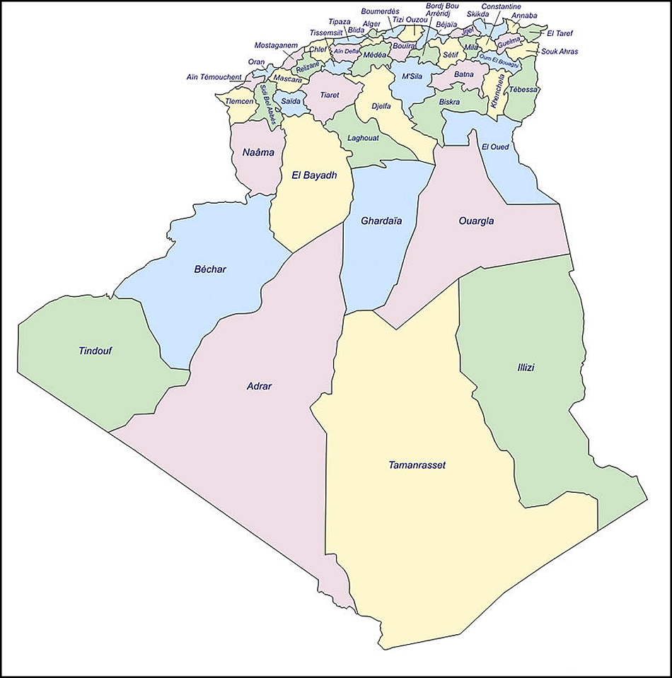

Slide 25
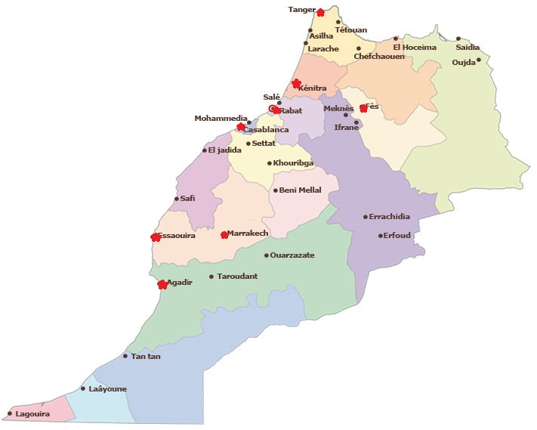

Slide 26
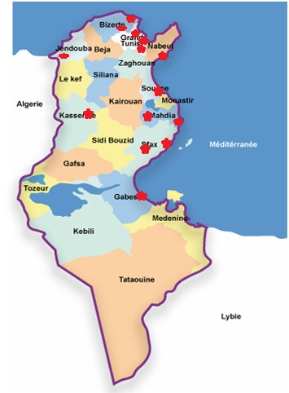

Slide 27
Conclusion
La médecine alternative se développe toute seule dans les pays du Maghreb
L’Etat qui est confronté à de gros problèmes de santé ne gène pas son évolution
Aujourd’hui, elle constitue un recours important pour la population

